Slide 1

Introductory Docker Tutorial
Hood-Price lab
Computation Tools Subgroup
9-13-2018

Slide 2
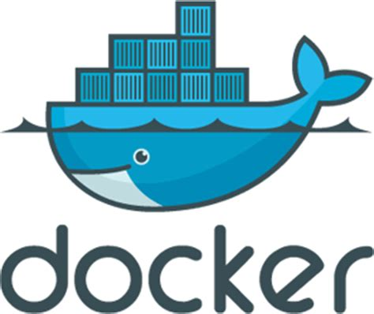
What is Docker?
An open-source project that automates the deployment of software applications inside containers by providing an additional layer of abstraction and automation of OS-level virtualization on Linux.
Enables the packaging, distributing and deploying of software along with all of its dependencies.
You have one composable functional unit of software.
Originally based on LXC

Slide 3
What does this mean for you?
You can deploy cross-platform functionality/analysis with all of the code/dependencies.
No more making code work with Python 3.2 on Windows 7
You can use and link complicated software systems without dealing with dependency `hell`
https://hub.docker.com/_/nginx/
https://hub.docker.com/_/postgres/
https://hub.docker.com/r/biocontainers/samtools/
https://hub.docker.com/_/redis/
Lots of great resources on the web

Slide 4
Introductory Tutorial
How to build your own images
How to run common docker containers

Slide 5
Basic Docker terminology
image – saved snapshot of OS, dependencies and code
container – a running image
volume - a directory on your machine that is mapped to a directory in the container

Slide 6
Install docker
Windows
https://store.docker.com/editions/community/docker-ce-desktop-windows
Mac
https://store.docker.com/editions/community/docker-ce-desktop-mac
Linux (3.8+ kernel)
Amazon linux (https://docs.aws.amazon.com/AmazonECS/latest/developerguide/docker-basics.html)
sudo yum update –y
sudo yum install –y docker
sudo service docker start
sudo usermod –a –G docker <myuser>

Slide 7
Docker basic commands
docker ps
Shows running containers
docker ps -a
Shows running and exited containers
docker stop <container_id>
Stops a running container
docker rm <container_id>
Removes a stopped container
docker start <container_id>
Starts a stopped container
docker images
Lists downloaded images
docker rmi <image_id>
Deletes an image
docker --help
get help

Slide 8
Building a Docker image
Dockerfile
A set of instructions that generate your image
Basically a shell script with a couple added commands
FROM <base image>:<tag>
The base image to start with
lightweight
alpine
fully functional
mysql
ADD <local path> <path in image>
Copies a file to the image
RUN <shell command>
Runs the given shell command inside the image
CMD [“<command>”, “<arg1>”, “<arg2>”]
The default command when you run this image as a container
EXPOSE <port number>
Exposes a port to linked docker containers
Lets docker containers talk to each other

Slide 9
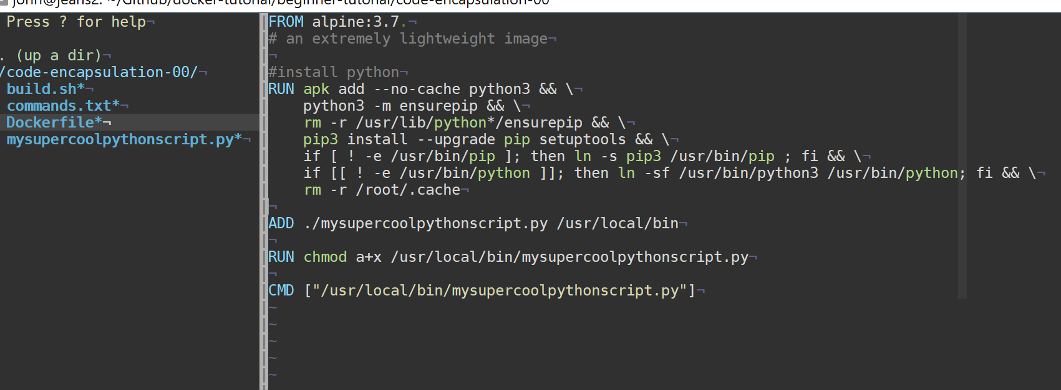
Dockerfile Example

Slide 10
Dockerfile

Slide 11
Dockerfile

Slide 12
Dockerfile

Slide 13
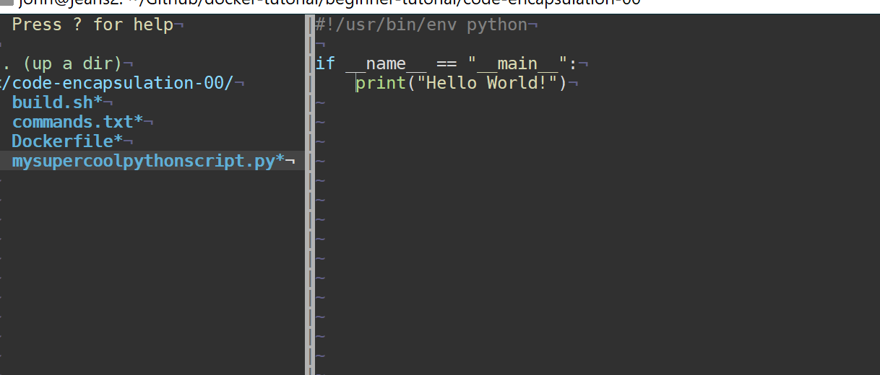
Script

Slide 14
Dockerfile

Slide 15
Dockerfile

Slide 16
Building a Docker image
cd into folder with Dockerfile
docker build .
docker build -t <sometag> .
docker build -t johncearls/hello-world .
docker build -t johncearls/hello-world:v1 .
A tag is a human readable name for your image
Local hash
docker build .
Creates an image with only a hash
Local but named
docker build -t hello-world .
creates hello-world:latest locally (latest is default image tag)
Named, tagged and sharable
docker build -t johncearls/hello-world:v1 .
Can push this to my repo(johncearls) on hub.docker.com
docker login
docker push johncearls/hello-world:v1
tagged as v1

Slide 17
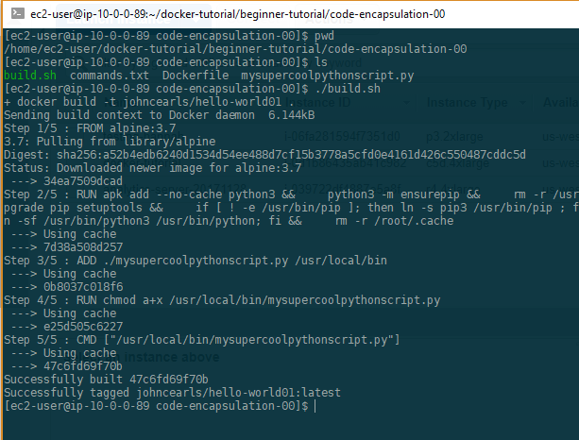
Building a Docker image

Slide 18
Building a Docker image

Slide 19
Building a Docker image

Slide 20
Building a Docker image

Slide 21
Building a Docker image

Slide 22
Building a Docker image

Slide 23
Building a Docker image

Slide 24
Running a container
docker run [--rm] -v <host_path>:<container_path> -p <host_port>:<container_port> <image> <command>
You can stop a long running container (a server for example)
docker stop <container name or id>
Make sure you delete when you are done
docker rm <container name or id>
or use --rm in run

Slide 25
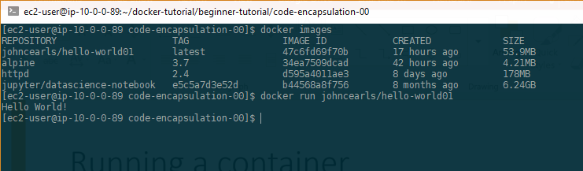
Basic Run

Slide 26
Basic Run

Slide 27
Basic Run

Slide 28
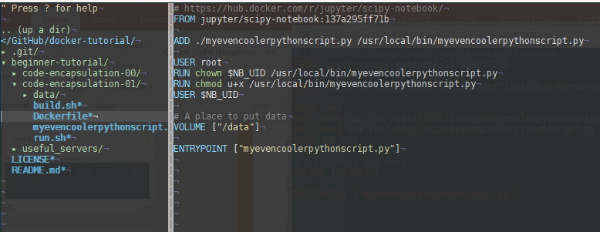
CMD vs Entrypoint

Slide 29
CMD vs Entrypoint

Slide 30
CMD vs Entrypoint

Slide 31
CMD vs Entrypoint

Slide 32
CMD v ENTRYPOINT
ENTRYPOINT runs first then CMD is appended
Default ENTRYPOINT [“/bin/sh”, “-c”]

Slide 33
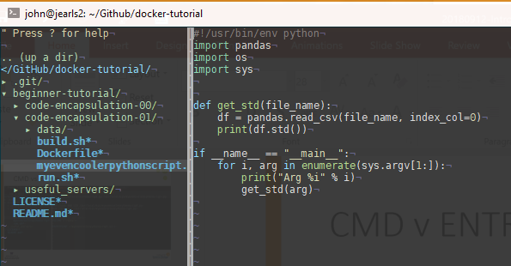
CMD v ENTRYPOINT

Slide 34
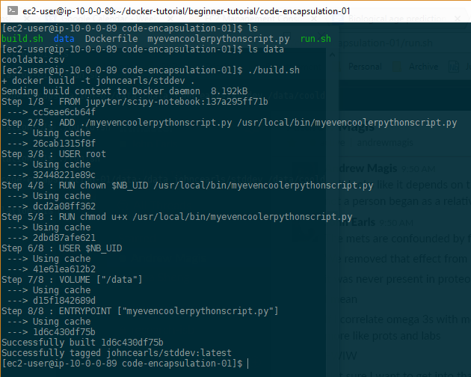
Build

Slide 35
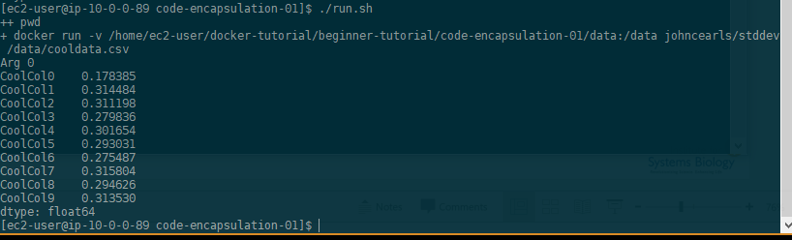
Run with parameters

Slide 36
Run with parameters

Slide 37
Some useful containers
https://hub.docker.com/explore/
Jupyter
https://hub.docker.com/r/jupyterhub/jupyterhub/
https://hub.docker.com/r/jupyter/datascience-notebook/
Postgres
https://hub.docker.com/_/postgres/
Biocontainers
Samtools: https://hub.docker.com/r/biocontainers/samtools/
Shiny server
https://hub.docker.com/r/rocker/shiny/
Apache
https://hub.docker.com/_/httpd/
The docs
https://docs.docker.com/

Slide 38
Start servers

Slide 39

Uncovered topics
Efficient container management
storage configuration
loopback v. LVM
Publishing volumes
HP lab uses ECS to deploy our containers(see me if interested)
Volumes
Much deeper than just mounting
Docker compose
start up a set of docker containers that work together
A flask app w/ database
Docker swarm
configure a scalable cluster of containers
A set of web servers with a redis cache
Kubernetes
A popular framework for managing docker cluster servers
AWS ECS
Elastic container service
Spin up containers without managing the server

